Slide 1
DataHub Opportunity
2022

Slide 2
Session Objectives
Create awareness of Customer & JOS co-selling opportunity w/ DataHub
Datahub introduction & demo
Collaboration - High-Level opportunity Structure
Call to action & Q&A

Slide 3
Market observations around data

Slide 4





Typical AWS datalake Customers use AWS Services to build scalable, cost efficient data projects
AWS Lambda
Data
EMR
Glue
Redshift
BI
ML
Sources
Staging
Process
Consume
Notes:
Share

Slide 5

This is what we usually show (most of the case)
« black box »
Business Units

Slide 6
This is what we usually show (most of the case)
Are you asking us
to delegate data
management
to one team ?
Business Units

Slide 7
This is what we usually show (most of the case)
What about security? And how can we access/share data?
Business Units

Slide 8
Building an enterprise data platform is foundational however very long, and highly unpredictable
Lots of Do It Yourself
Expensive
Hard to Secure
Hard to Use
Long, risky dev cycle,
complex stack to integrate
& productionize.
Hard to find DevOps, Big Data expertise to
Implement, manage and operate, and ensure SLAs.
Securing cloud +
platforms end-to-end
for enterprise data.
Hard to deliver easy
access to data with
ML/AI/analytics tools.
We observe customers building it on their own
have with mixed results.

Slide 9
DataHub’s Offerings provides faster, predictable outcomes
Industrial
Distributed
Predictable
Cost-efficient
Scalable
JOS built solution
JOS maintained
JOS Operated
Simple User Experience
Execution
Unique
Easy to Use Solution
Methodological Frameworks
Operational Models
Best Skills On The Market
Open to Partners
Tactical
Centralized
Complex
Expensive
Unpredictable

Slide 10
Datahub overview

Slide 11
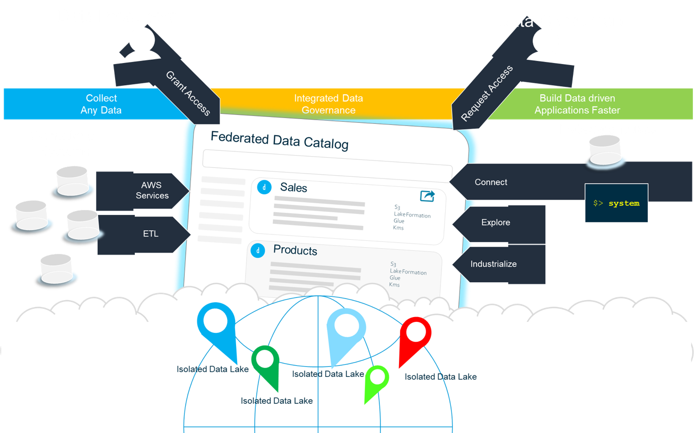
Datahub Overview One stop shop for all data work
A simplified enterprise data management solution for distributed datalakes.
Aiming to unlock data and accelerate the delivery of data applications, while removing the « plumbing » out of the way.
Comes with:
Business Data Catalog
Data Pipelines (Spark based)
Data Connectors
ML Pipelines (SageMaker)
Notebooks
BI tools
SQL Editor
Sharing capabilities
and more to come

Slide 12
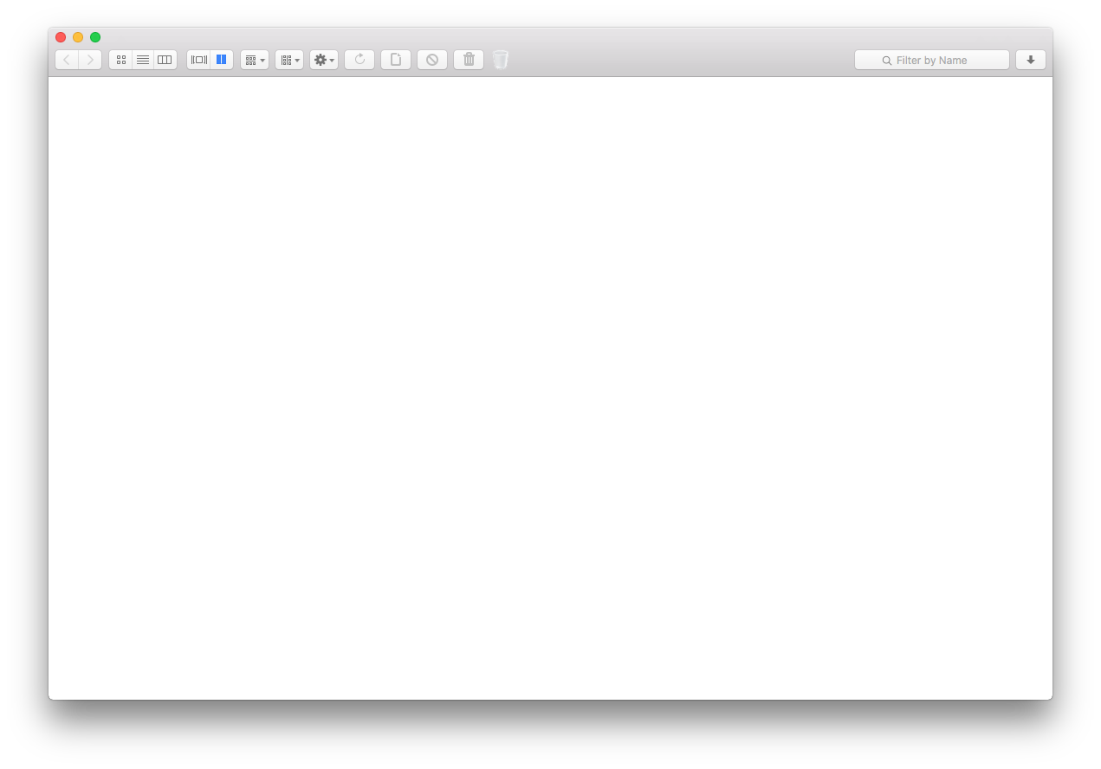
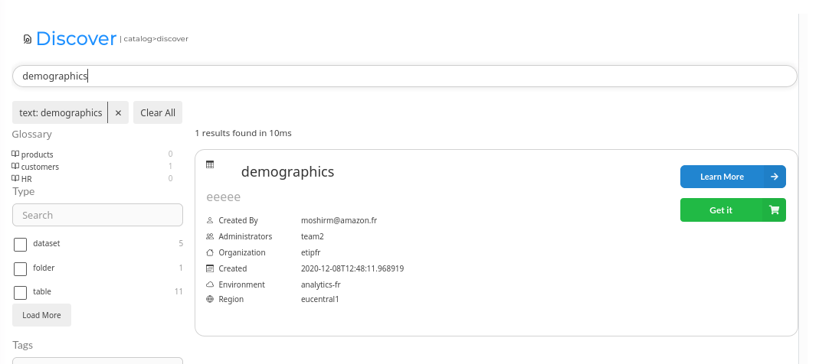
Datahub Overview 1. Data Discovery
For any data user
Discover data in the catalog, contribute by ingesting data and request access to datasets

Slide 13
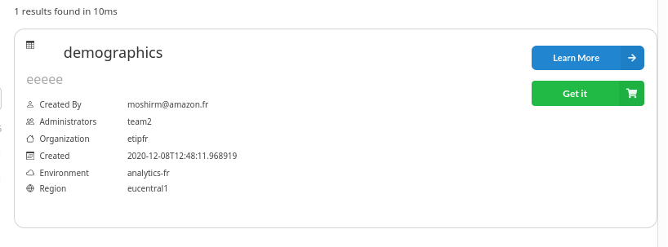
Datahub Overview 2. Data Accessibility
For any data user
Datahub guarantees access to the data in the catalog. Standarise and simply sharing mechanisms. No IT Ticket to cut, or database passwords sent over emails.

Slide 14
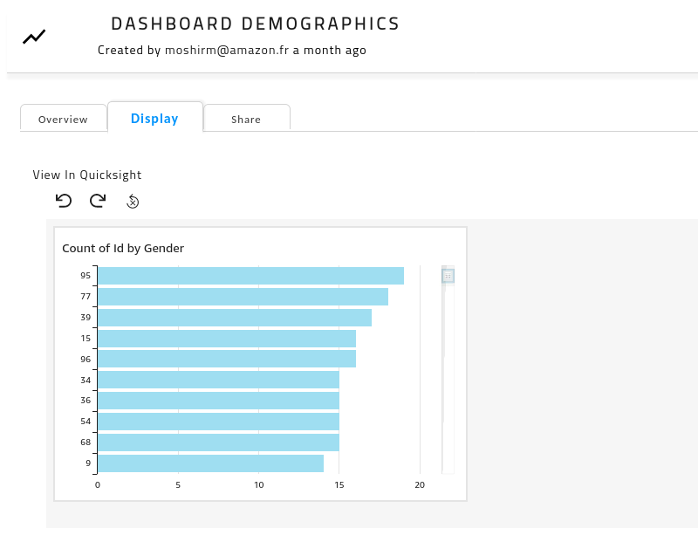
Datahub Overview 3. Integrated dashboards
For data analysts
Request access to data, visualize and gain insights from data with integrated BI and dashboards

Slide 15

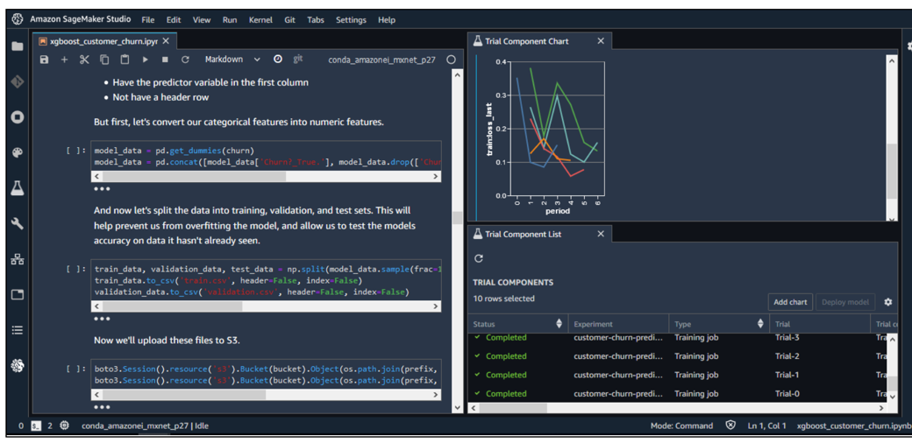
Datahub Overview 4. Machine Learning solutions
For data scientists
Search catalog, connect to data and build ML solutions using Amazon SageMaker

Slide 16
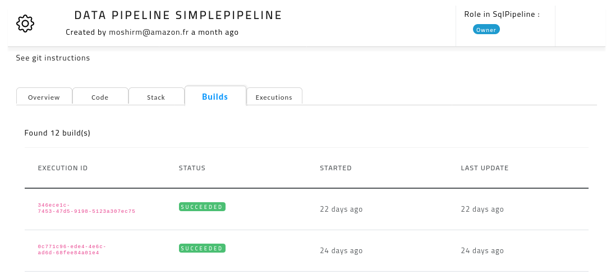
Datahub Overview 5. Data and automation pipelines
For data and ML engineers
Build integrated data and ML automation pipelines and share insights accross organisation

Slide 17
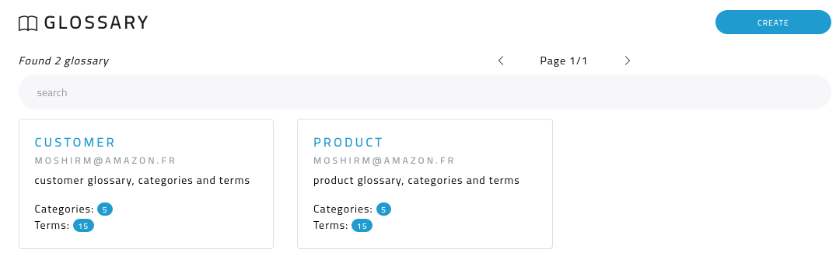
Datahub Overview 6. Common data vocabulary
For data stewards
Define, categories terms
and link to any data assets to enforce common vocabulary across all sources

Slide 18
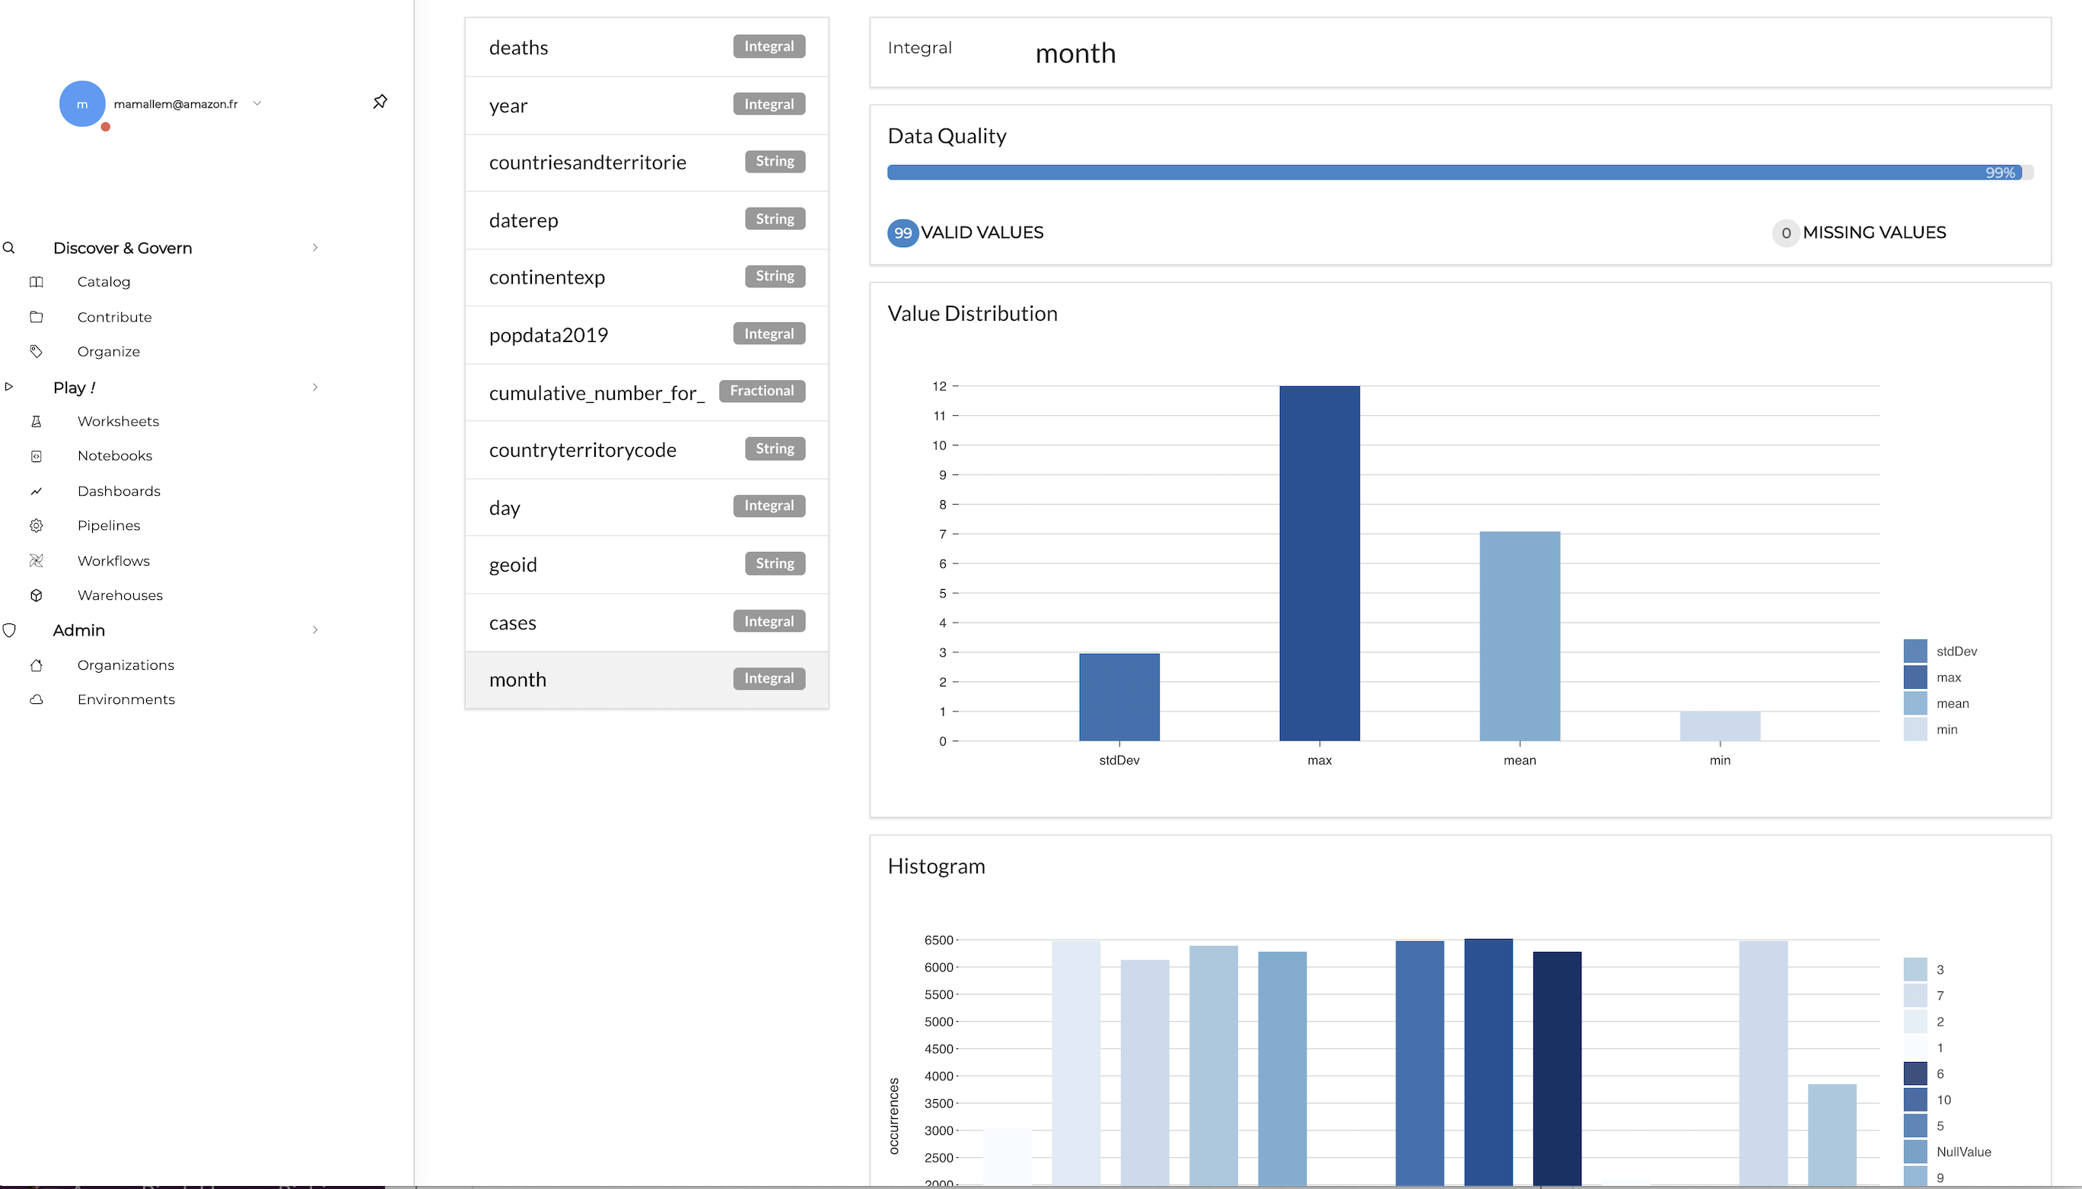
Datahub Overview 7. Data quality
For data stewards
Integrated data profiling and data quality to build trust in data

Slide 19
When to Engage? With Whom?
Triggers
Targets
We get no value out of data
We need to make data accessible
No one uses our datalake
We dont know how to build a data platform
CIO, hired to implement modern data platform
CDO, hired to monetize data
CEO, hired to transform company business model
Industries
We have references in
E&U, Finances, Healthcare, Transportation, Automotive in France and EMEA

Slide 20
Demo

Slide 21
Collaboration - High-Level opportunity Structure
New Opportunity
Customer
DataHub Scaling Mechanism
Datahub Solution Platform
Customer Use Case Roll-out
AWS Leads
Customer Leads, JOS supports*
Engagement mgt & IP
Architecture & Security review, Solution Set-up, Integration & Deployment
Knowledge transfer & operational readiness
Estimate cost**
150k€
Estimate Effort:
4 weeks
4 weeks
No min. Use Cases
Use Case definition, integration, deployment into DataHub
Use Case Industrialization
Estimate cost per Use Case***
35K€-55k€
Estimate Effort:
15 days * 2 resources per Use Case
Custom effort
*JOS support on 1st Use Cases, until Customer can take full lead.
**Estimate cost only, actual cost will vary on a deal by deal and customer basis.
***Estimate based on mix of mkt and JOS rates, final cost will vary on real rates

Slide 22
Call to Action
Get in touch w/ JOS for more information, additional training & resources
Include JOS in all discussions from early stage opportunity discovery and customer engagement – 1 team approach
Refer to public Datahub stories:
https://aws.amazon.com/solutions/case-studies/engie-aws-analytics-case-study/
http://www.bbc.com/storyworks/specials/the-intelligent-era/better-data-better-energy/

Slide 23
Thank you.

